Slide 1


ELECTVIZ
ELECTION DATA VISUALIZATION FOR MEDIA
PRESENTED BY TEAM C
GEETHIKA SUNIL
JANHAVI SHARMA
OMKAR DONGARE
ASHUTOSH JHA

Slide 2
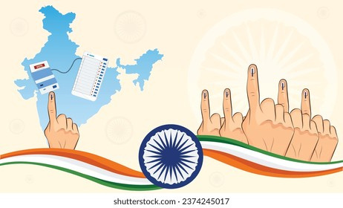
PROJECT OBJECTIVE
  Integrate multi-election historical datasets
  Standardize and clean public election data
  Design star schema data model
  Develop interactive dashboards for media analysis
  Enable real-time and historical election insights
  Support data-driven reporting and broadcast visualization

Slide 3

PROJECT DESCRIPTION
The system:
  Imports multi-year Lok Sabha and Vidhan Sabha datasets
  Cleans and standardizes state, constituency, party, and candidate data
  Creates interactive dashboards with filtering and drill-down
  Simulates real-time election result updates
  Enables visualization of vote share, turnout and party performance.

Slide 4

MILESTONE 1
  Historical data from multiple elections imported and cleaned
  Star schema created with valid relationships
    Candidates
    Votes
    Constituencies
    Parties

Slide 5

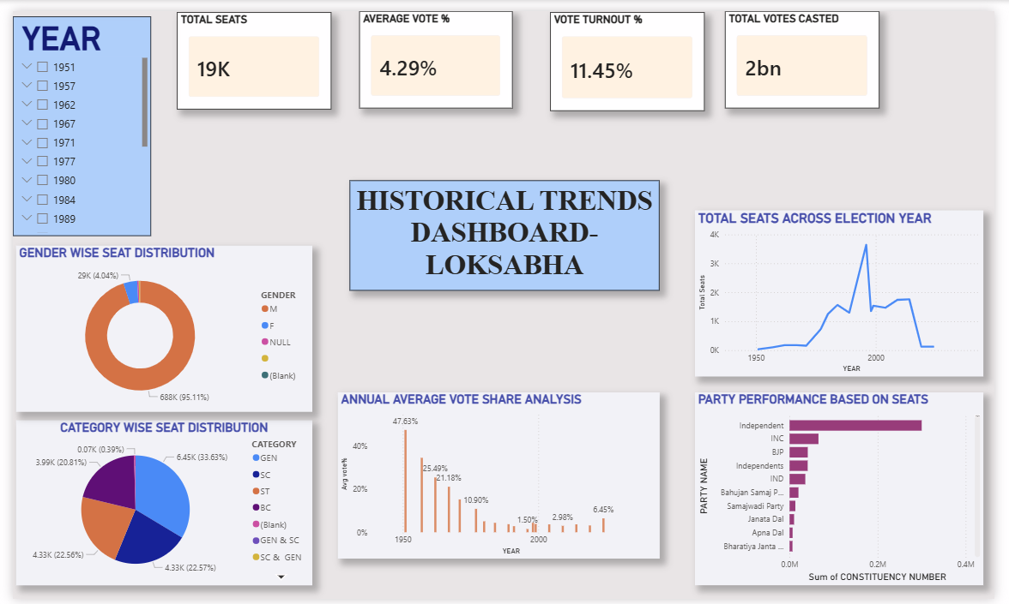
MILESTONE 2
HISTORICAL TRENDS DASHBOARD-LOKSABHA

Slide 6
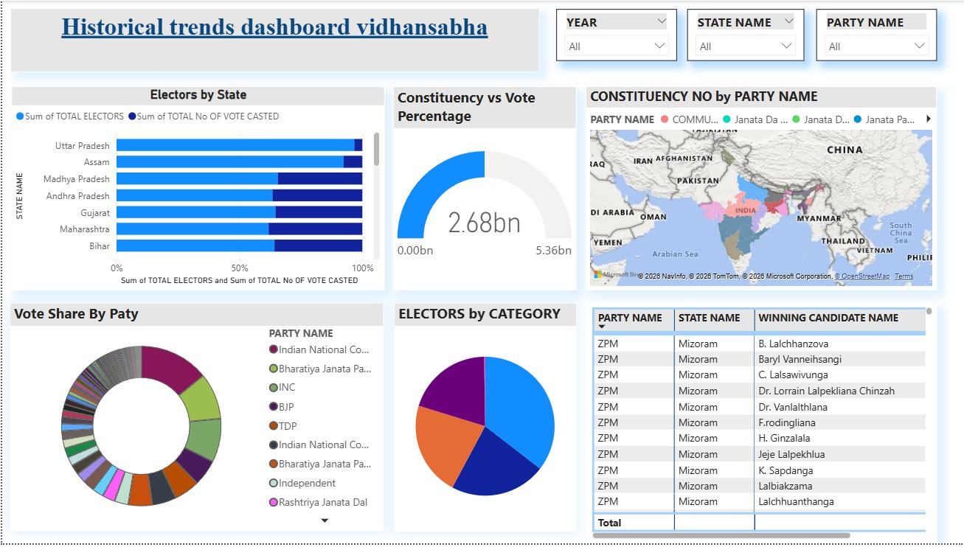
HISTORICAL TRENDS DASHBOARD-VIDHANSABHA

Slide 7

HISTORICAL TRENDS DASHBOARD
  Vote Share Dashboard completed
  Turnout Dashboard completed
  Filter functionality enabled
    Year
    Party
    State

Slide 8
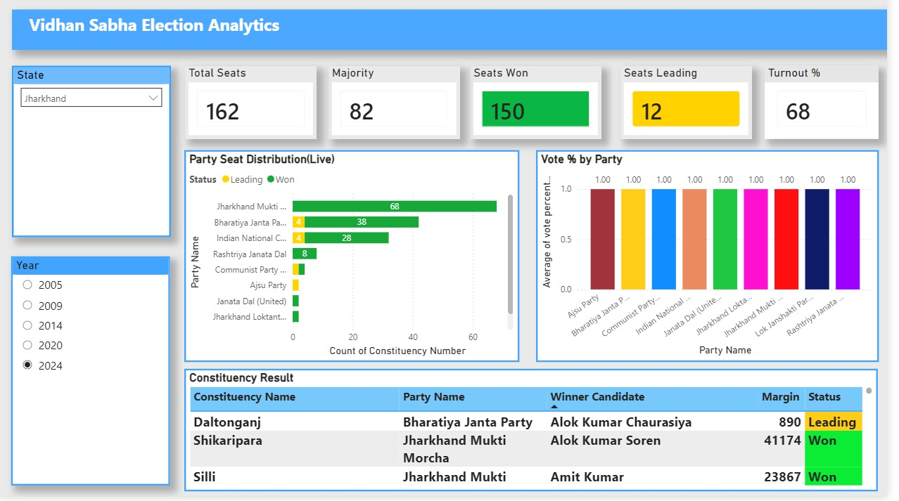
MILESTONE 3
REAL TIME RESULTS DASHBOARD

Slide 9

KEY INSIGHTS
  Current leading party and seat distribution.
  Narrow margins in competitive constituencies.
  Regional dominance patterns.
  Vote percentage gap between major parties.
  Trend comparison with previous elections.

Slide 10

MILESTONE 4
Turnouts & Demographic Analysis
    Scope of Model: Analyze voter turnout patterns across states and demographics.
    Objective: Understand how demographic factors influence voter participation.
    Level of Analysis: State and constituency-level comparison with urban–rural segmentation
    .
    Key Features: Interactive filtering by year, state, gender, and region.
    Visualization: Bar charts, pie charts, and heatmaps for turnout distribution.
    Insights: Identifies regions and demographics with high or low voter engagement.

Slide 11
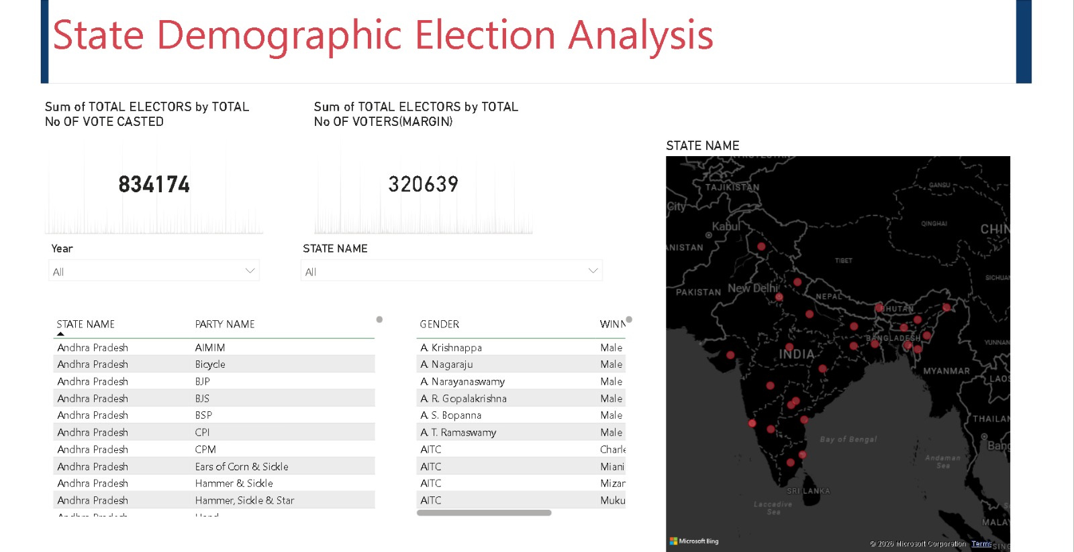
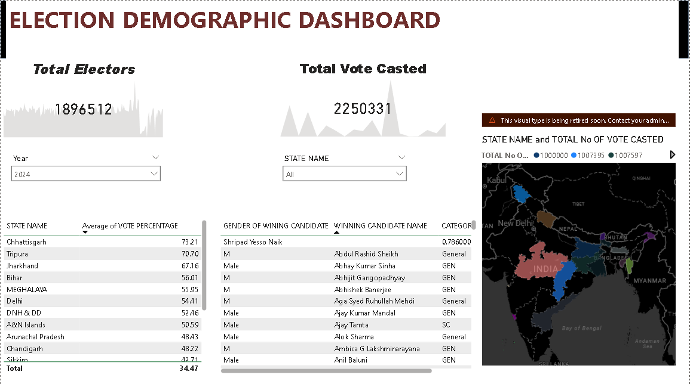
DEMOGRAPHICS DASHBOARD
11

Slide 12

MILESTONE 5
PARTY AND CANDIDATE PERFORMANCE ANALYSIS
    Analyzes party-wise seat share and vote percentage across elections
    Compares performance of different parties over multiple years
    Evaluates candidate win/loss margins and re-election trends
    Identifies top-performing candidates and competitive constituencies
    Provides drill-down analysis at state and constituency levels

Slide 13
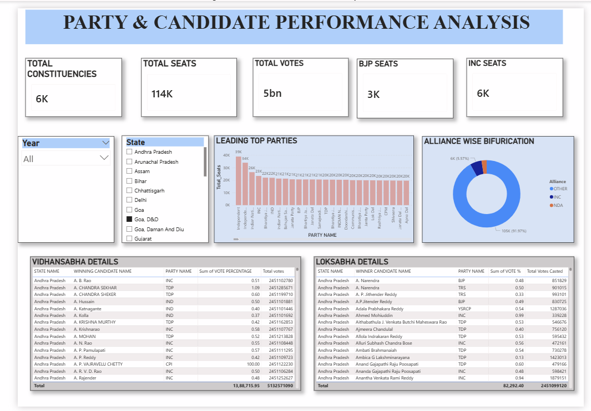

Slide 14

PROJECT EXECUTION DETAILS
The project execution included:
  Multi-source election dataset integration
  Data cleaning and transformation using Power Query
  DAX measures for:
    Vote %
    Seat Share
    Turnout %
  Dashboard development in Power BI
  Interactive filtering and drill-through configuration

Slide 15
CHALLENGES FACED
  Inconsistent state-wise dataset formats
  Large volume of multi-year data
  Standardizing party and constituency names
  Creating accurate DAX measures
  Optimizing dashboard performance

Slide 16
CONCLUSION
    Successfully integrated and standardized multi-state election datasets.
    Developed interactive Power BI dashboards for historical, real-time, and demographic analysis.
    Enabled clear visualization of party performance, voter turnout, and electoral trends.
    Provided data-driven insights to support news reporting and analytical decision-making.

